Slide 1

Monster
Inc
Childhood
memories
Presentation by group TTAP|2024|International University

Slide 2

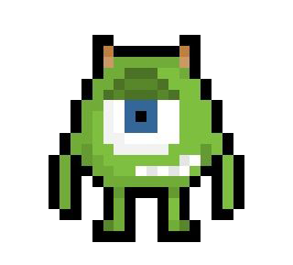
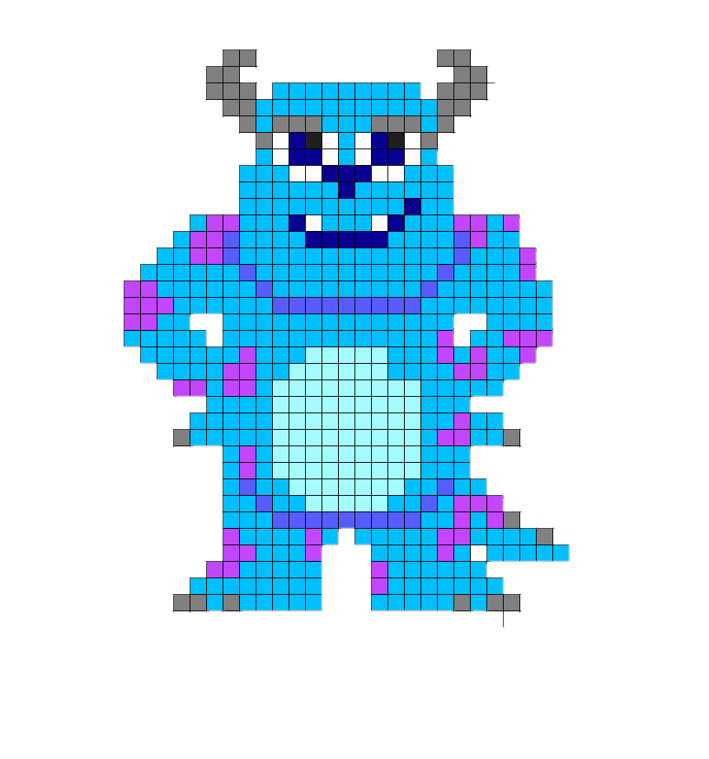
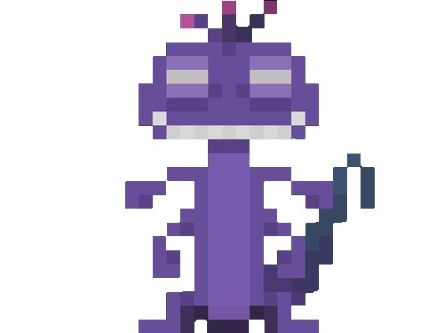
OUR TEAM
TAN
PHAT
TU
ANH
ITCSIU21231
ITCSIU21214
ITCSIU21243
ITITIU21157

Slide 3
TABLE OF CONTENTS
01
02
03
04
05
IDEAS & TECHNIQUES
CORE CONCEPTS
GAME DESIGN
GAMEPLAY DEMO
CONCLUSION

Slide 4
01
IDEAS &
TECHNIQUES

Slide 5
—Motivation
“We are working with this game as our project lab is a 4-credit course. During our investigation into how to create 2D games with Java, we remembered the chicken invaders game and the movie Monster, Inc which were popular in our childhood..”

Slide 6
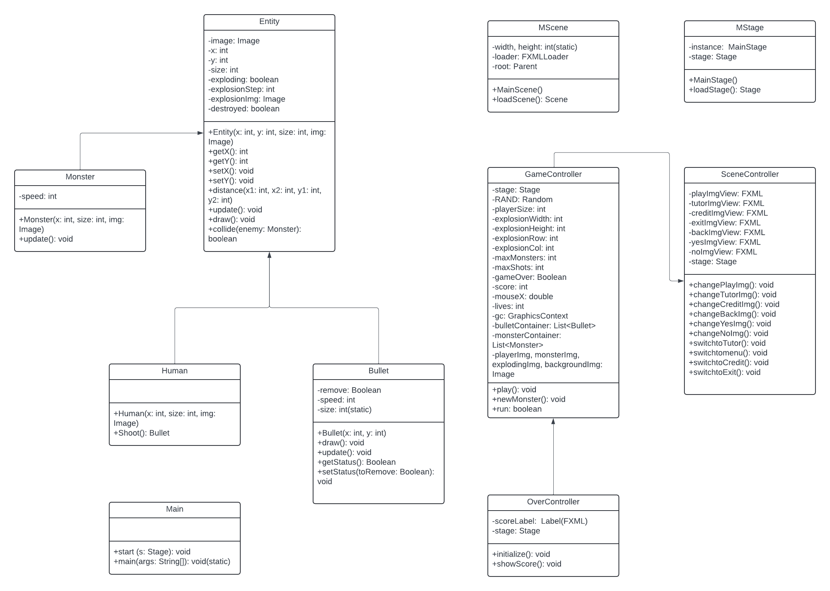
UML DIAGRAM

Slide 7
02
OOP CONCEPTS IMPLEMENTATION

Slide 8
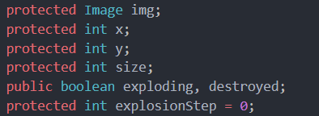
ENCAPSULATION

Slide 9
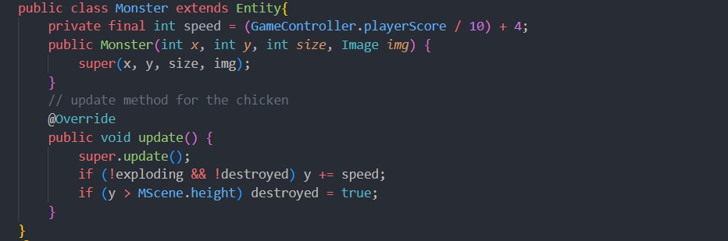
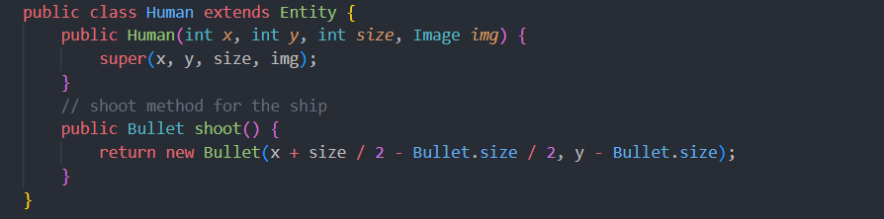
INHERITANCE

Slide 10
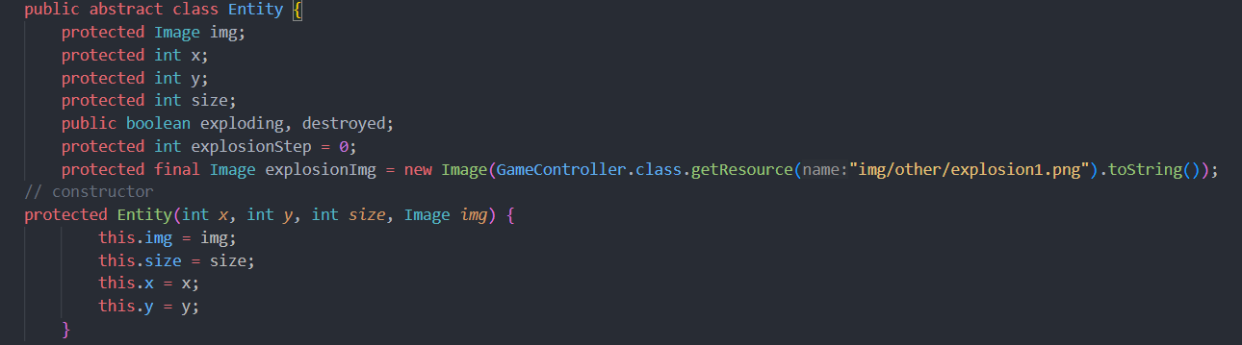
ABSTRACT

Slide 11
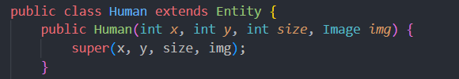
POLYMORPHISM

Slide 12
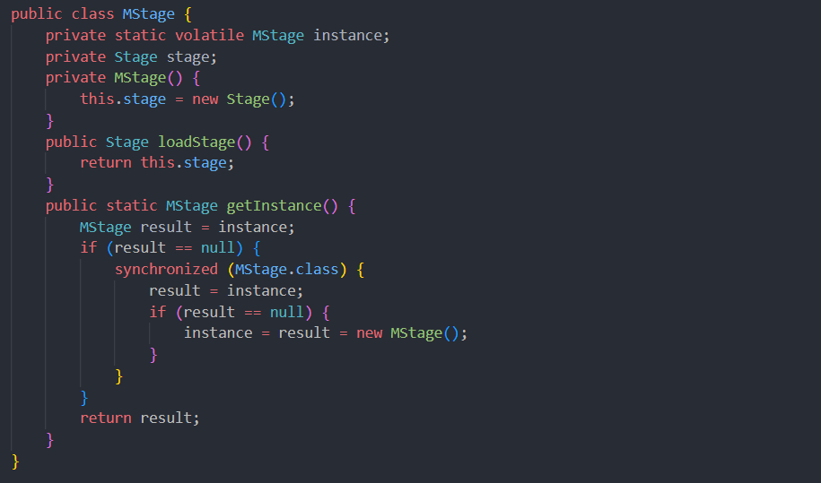
DESIGN PATTERN

Slide 13
03
GAME
DESIGN

Slide 14
BACKGROUND
“ The idea for background is based on the setting of the game, which is space and chickens “

Slide 15
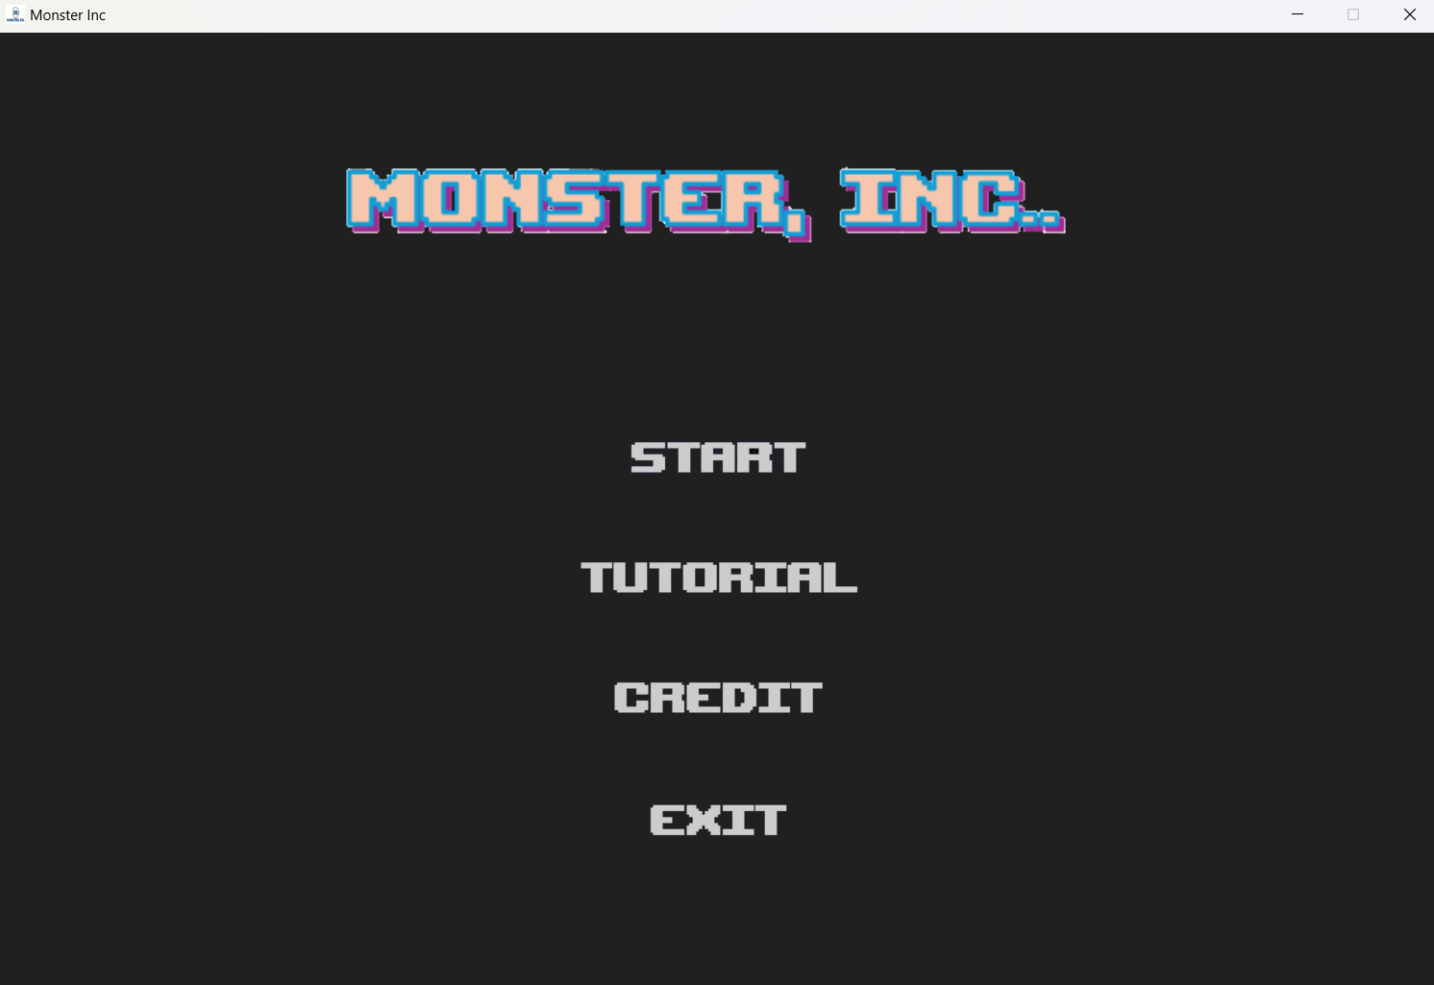
GAMES MENU

Slide 16
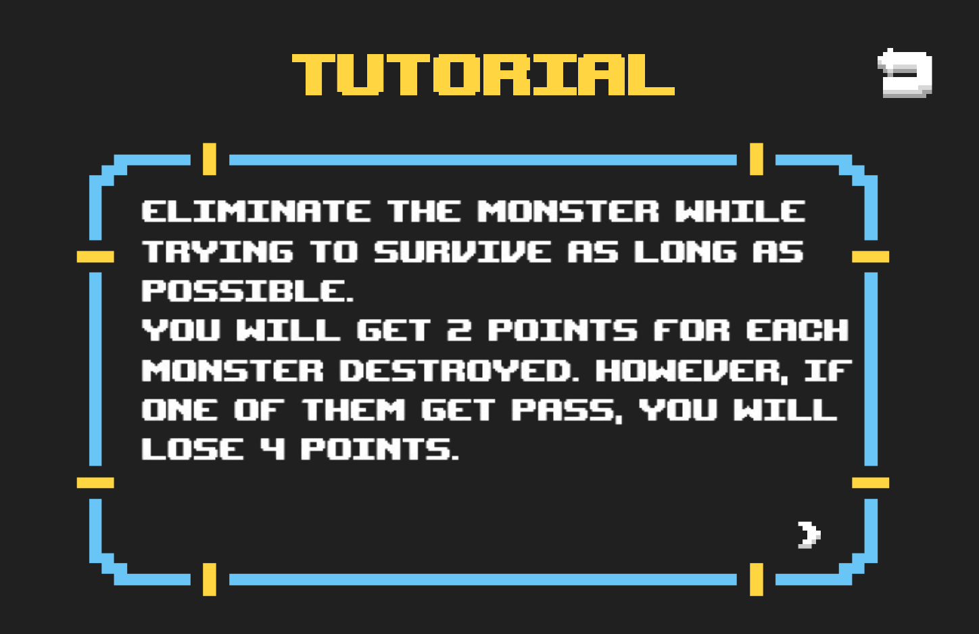
TUTORIAL

Slide 17
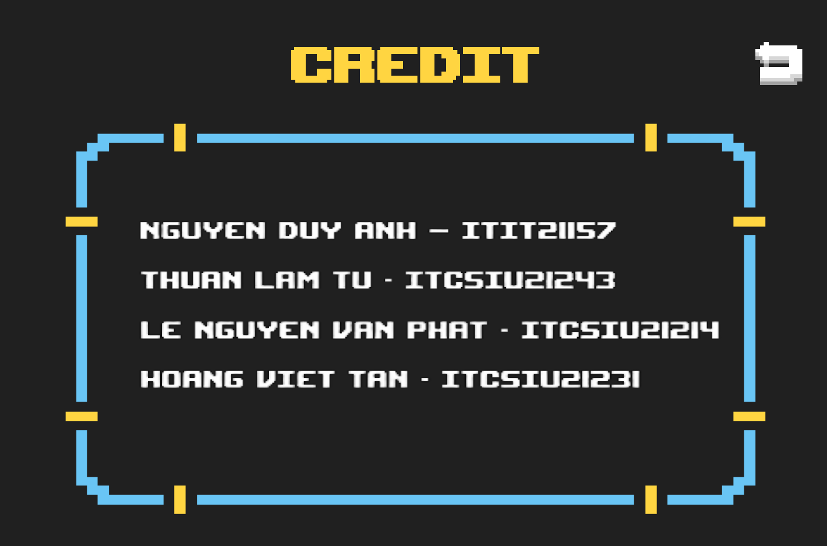
CREDIT

Slide 18
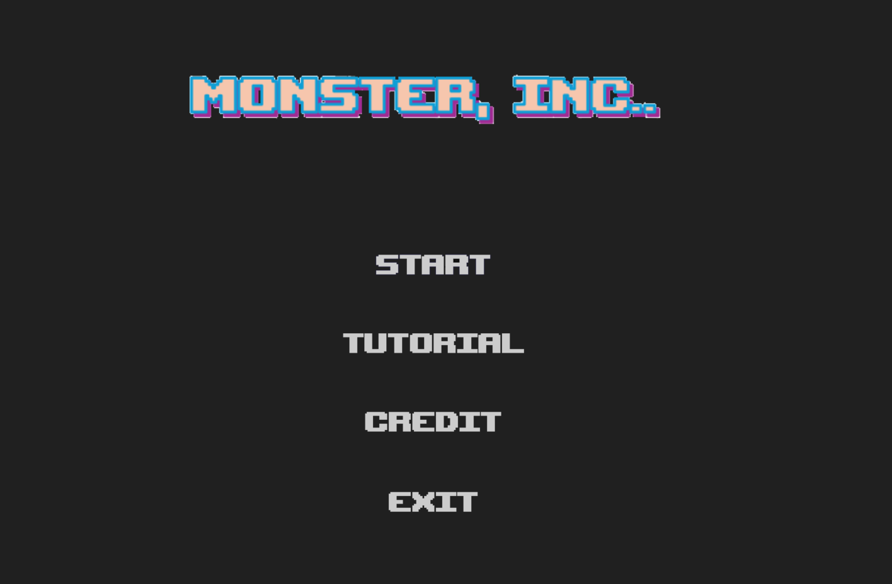
GAMES MENU

Slide 19
START GAME!!!

Slide 20
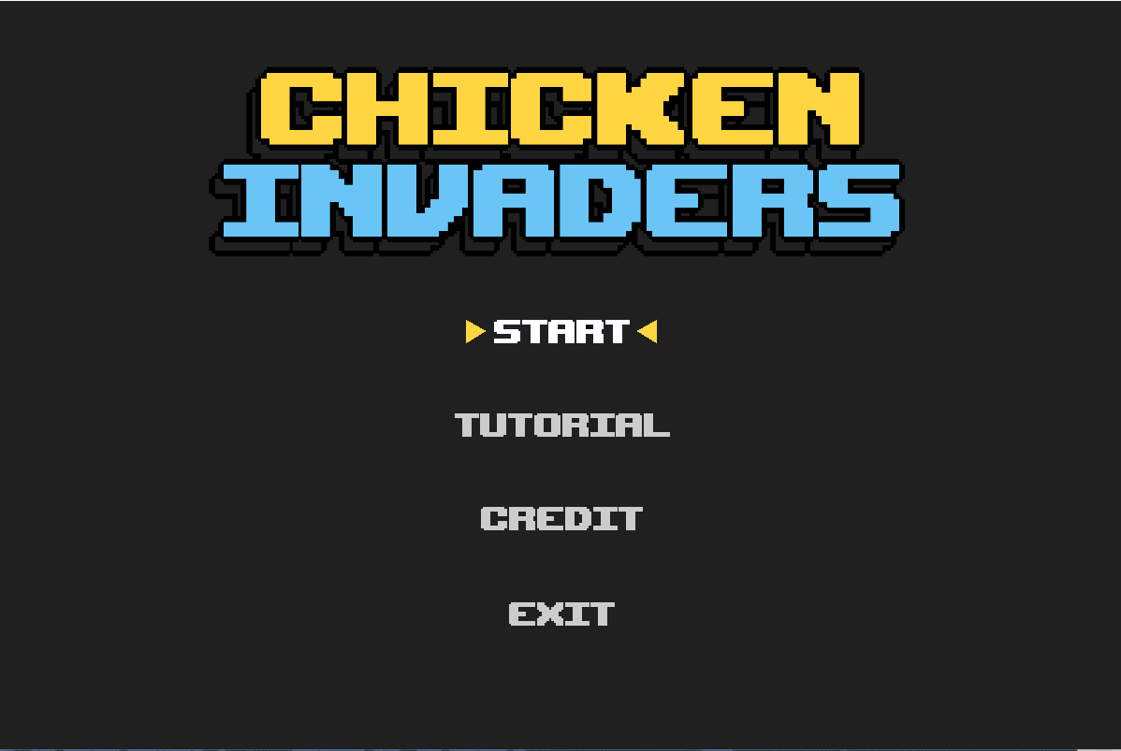


Slide 21
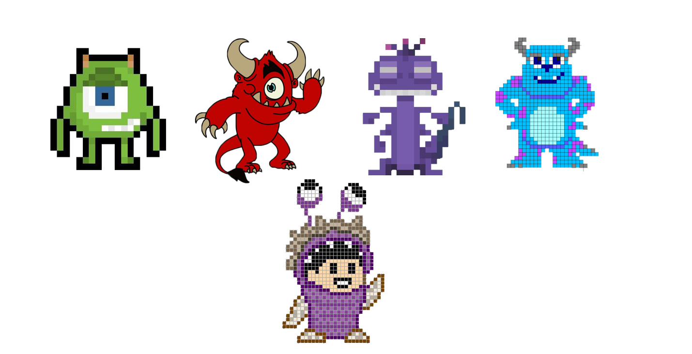
CHARACTERS

Slide 22
04
GAMEPLAY
DEMO

Slide 23
05
CONCLUSION

Slide 24

ACHIEVEMENT
Effective Use of OOP
Game Logic Implementation
User Interface Implementation
Performance Optimization

Slide 25

FUTURE WORK
Multiplayer Mode
Screen Splitting
High Score Database

Slide 26
REFERENCE
mostafaHegab. (n.d.). mostafaHegab/Chicken-Invaders: Simple Chicken Invaders Game with JAVA. Retrieved from https://github.com/mostafaHegab/Chicken-Invaders
UML class: Lucidchart. (n.d.). Retrieved from https://lucid.app/lucidchart/c6e383ae-e074-4fc5-ae37-65484a9a7a34/edit?invitationId=inv_0a814f23-793c-4559-a23f-30c2dc288661&page=HWEp-vi-RSFO#
Best 55+ 8. (n.d.). Retrieved from https://wallpapercave.com/w/wp7872568
Programming Space Invaders in Java (fx) Tutorial 1/2. (2019). Retrieved from https://www.youtube.com/watch?v=0szmaHH1hno&list=WL&index=4&t=18s
Programming Space Invaders in Java (fx) Tutorial 2/2. (2019). Retrieved from

Slide 27


THANK
YOU

